Slide 1
Computer Parts
Different kinds of computer parts and its function

Slide 2
PS/2 Mouse Port
A PS/2 mouse port is a small round connector on a computer that allows a computer mouse to be connected. It is an older technology that uses a small 6-pin DIN connector.

Slide 3
PS/2 Keyboard Port
Similar to the PS/2 mouse port, the PS/2 keyboard port is a small round connector on a computer that allows a keyboard to be connected. It is also an older technology that uses a small 6-pin DIN connector.

Slide 4
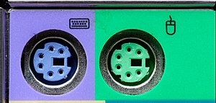

Slide 5
HDMI Connector
HDMI (High-Definition Multimedia Interface) is a digital interface used to transmit high-definition video and audio signals between devices. An HDMI connector allows high-quality video and audio to be sent from a computer to an external device such as a monitor or TV.

Slide 6
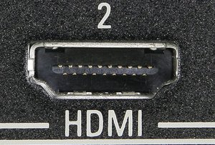

Slide 7
DVI Connector
DVI (Digital Visual Interface) is another digital interface used to transmit high-quality video signals between devices. A DVI connector allows high-quality video to be sent from a computer to an external device such as a monitor.

Slide 8
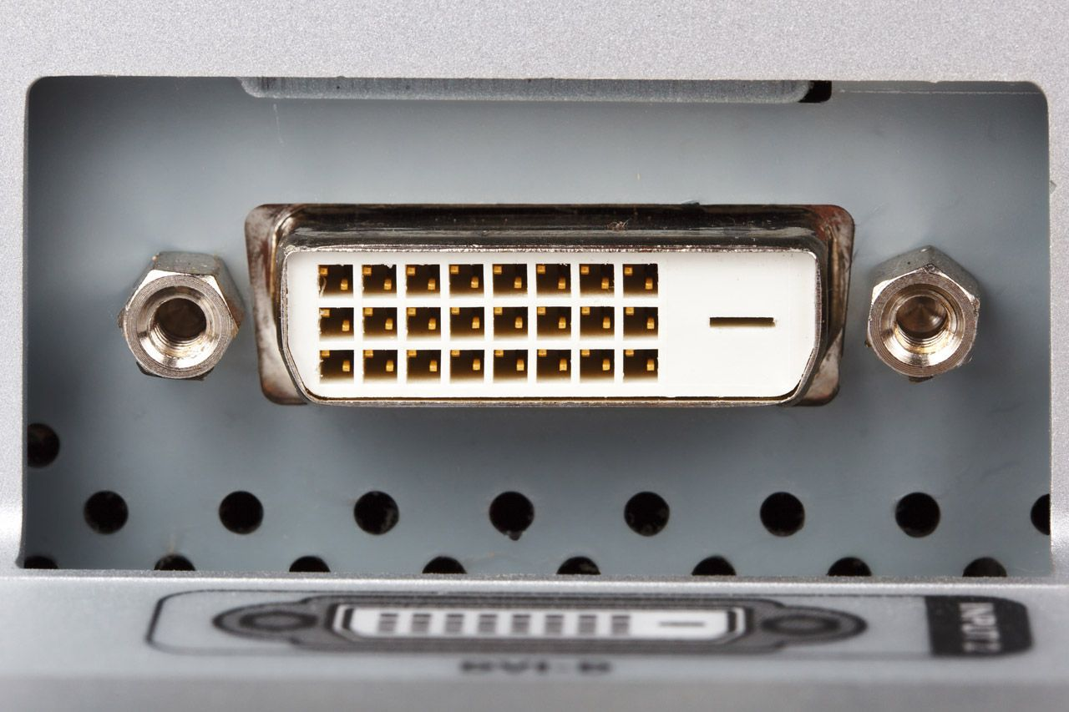

Slide 9
VGA Connector
VGA (Video Graphics Array) is an older analog interface used to transmit video signals between devices. A VGA connector allows video to be sent from a computer to an external device such as a monitor.

Slide 10
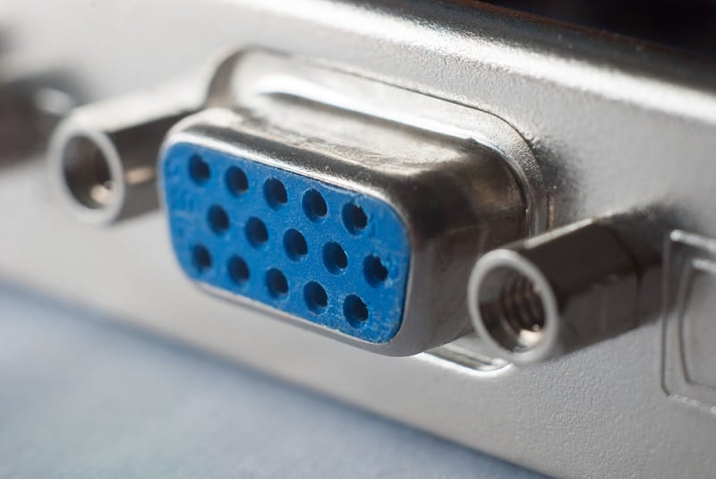

Slide 11
eSATA ports
An eSATA port is an external SATA (Serial Advanced Technology Attachment) interface used to connect external storage devices to a computer.

Slide 12
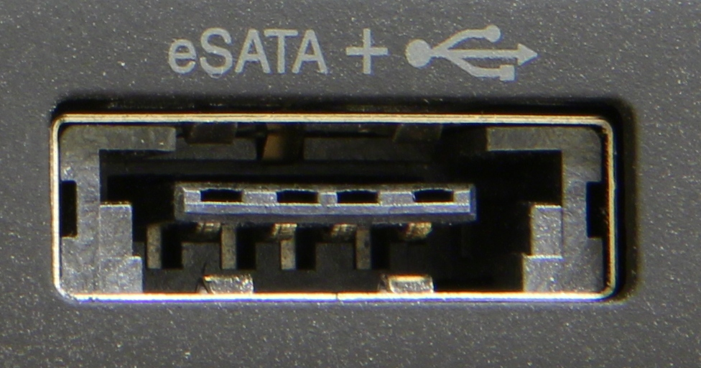

Slide 13
USB ports
USB (Universal Serial Bus) is a common interface used to connect a wide variety of devices to a computer. USB ports allow devices such as mice, keyboards, printers, and external storage devices to be connected to a computer.

Slide 14
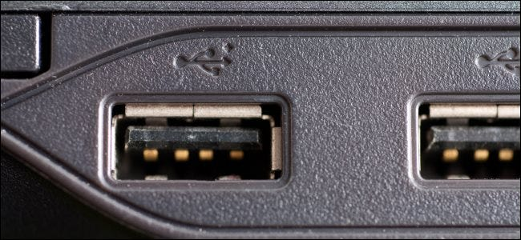

Slide 15
RJ45 ports
An RJ45 port is a network interface used to connect a computer to a wired network. It is commonly used for Ethernet connections.

Slide 16
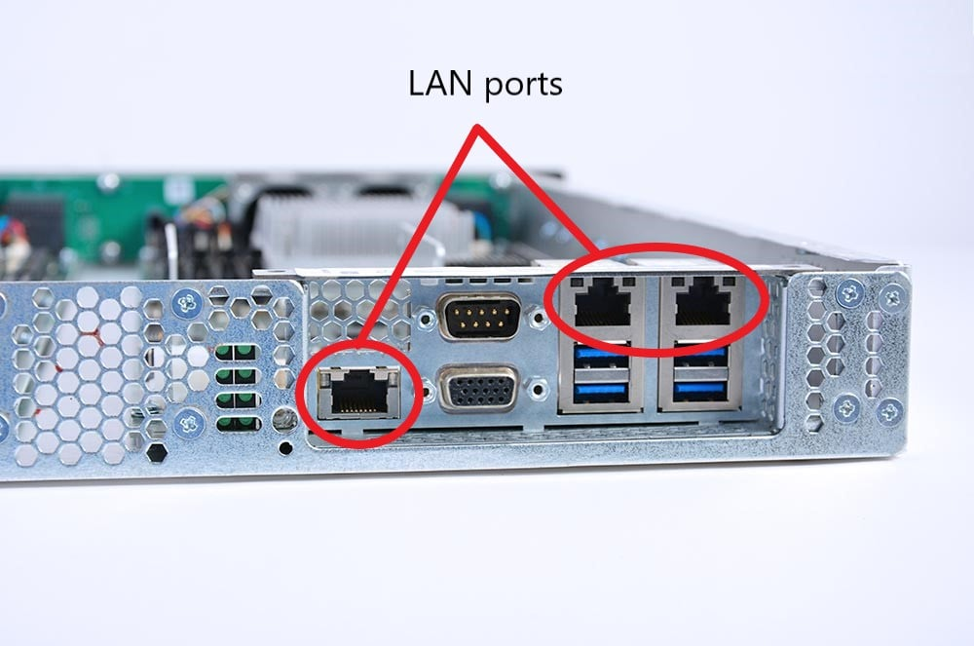

Slide 17
Audio ports
Audio ports are used to connect audio devices such as speakers and microphones to a computer. Different types of audio ports include:
line in (light blue)
Used to connect external audio sources such as CD players or cassette decks.
line out (lime)
Used to connect speakers or headphones.
microphone (pink)
Used to connect an external microphone.
side speaker out (gray)
Used for surround sound systems.
rear speaker out (black)
Used for surround sound systems.
center/subwoofer (yellow orange)
Used for surround sound systems.

Slide 18
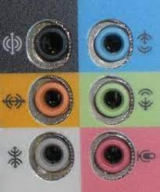

Slide 19
PCI-E x16 slot
A PCI-E (Peripheral Component Interconnect Express) x16 slot is a high-speed interface used to connect expansion cards such as graphics cards to a computer.

Slide 20
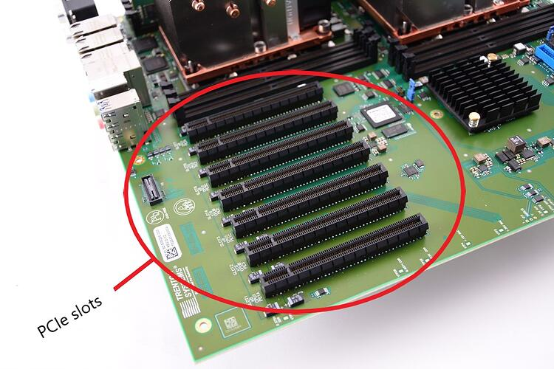

Slide 21
PCI-E x4 slot
A PCI-E x4 slot is another type of PCI-E interface that allows expansion cards to be connected to a computer.

Slide 22
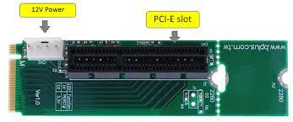

Slide 23
PCI slots
PCI (Peripheral Component Interconnect) slots are an older interface used to connect expansion cards to a computer.

Slide 24
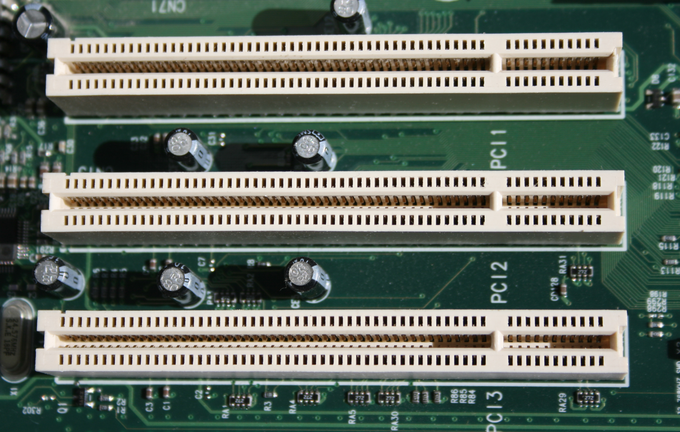

Slide 25
Super I/O
Super I/O is a type of hardware component that is responsible for managing input/output functions on a computer.

Slide 26
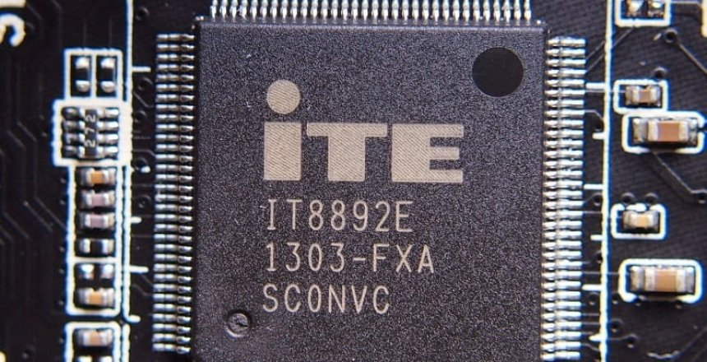

Slide 27
COM port
A COM port is a legacy interface used to connect serial devices such as modems, mice, and some older printers to a computer.

Slide 28
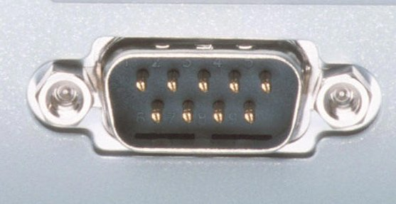

Slide 29
SATA2 connectors
SATA (Serial Advanced Technology Attachment) connectors are used to connect storage devices such as hard drives and solid-state drives to a computer. SATA2 is an older version of the SATA interface that provides slower data transfer speeds compared to newer versions.

Slide 30
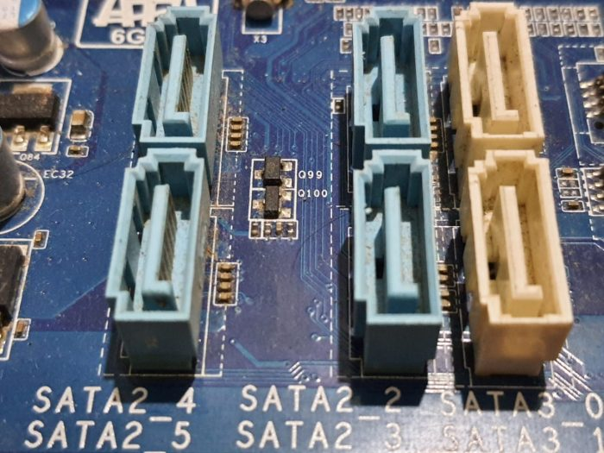

Slide 31
IDE connector
An IDE (Integrated Drive Electronics) connector is an older interface used to connect storage devices such as hard drives and CD/DVD drives to a computer. It has largely been replaced by the SATA interface.

Slide 32
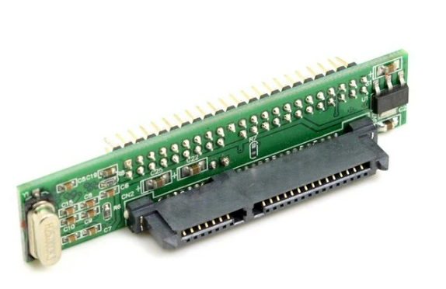

Slide 33
DDR3/4 DIMM Memory slot
DDR3 (Double Data Rate 3/4) is a type of computer memory used to store data that the CPU can access quickly. DIMM (Dual In-Line Memory Module) slots are the physical slots on a motherboard where memory modules are installed.

Slide 34
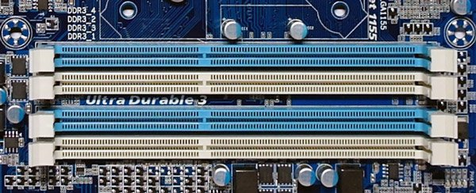

Slide 35
CPU
The CPU (Central Processing Unit) is the "brain" of a computer. It is responsible for executing instructions and performing calculations that allow the computer to perform tasks. The CPU is typically located on the motherboard and is connected to other components through a variety of interfaces

Slide 36
